Slide 1

Data Structures
Unit-6
Dept. of CSE,
RGUKT IIIT Srikakulam

Slide 2
Graphs

Slide 3
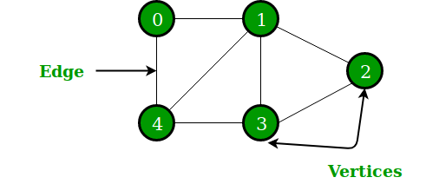
What is a graph?
A graph is an ordered pair G=(V,E) comprising a set V of vertices or nodes and a collection of pairs of vertices from V called edges of the graph.
V={ 0,1,2,3,4}

Slide 4
Difference between Tree and Graphs:
Trees | Graphs
Hierarchical order | No hierarchy
Relationship | No Relationship
Restriction on number of nodes Tree contains Root node No loops | No restriction No root node May exist Loops or may not

Slide 5
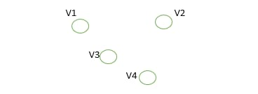
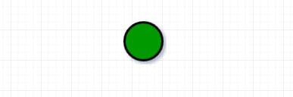
Types of Graph:
1) Undirected Graph
2) Directed Graph
3) Directed Acyclic Graph
4) Multi graph
5) Simple graph
6)Labelled graph
7) Weighted and un weighted graph
8) Complete Graph- n vertices having n(n-1)/2 edges
9) Connected graph- There is a path from U to V in graph G.
-> A Connected graph that does not have cycles is called tree.
10) Bi-connected graph
11) Null Graph
12)Trivial graph
Null Graph
Refer the class notes for Definitions
Trivial Graph

Slide 6
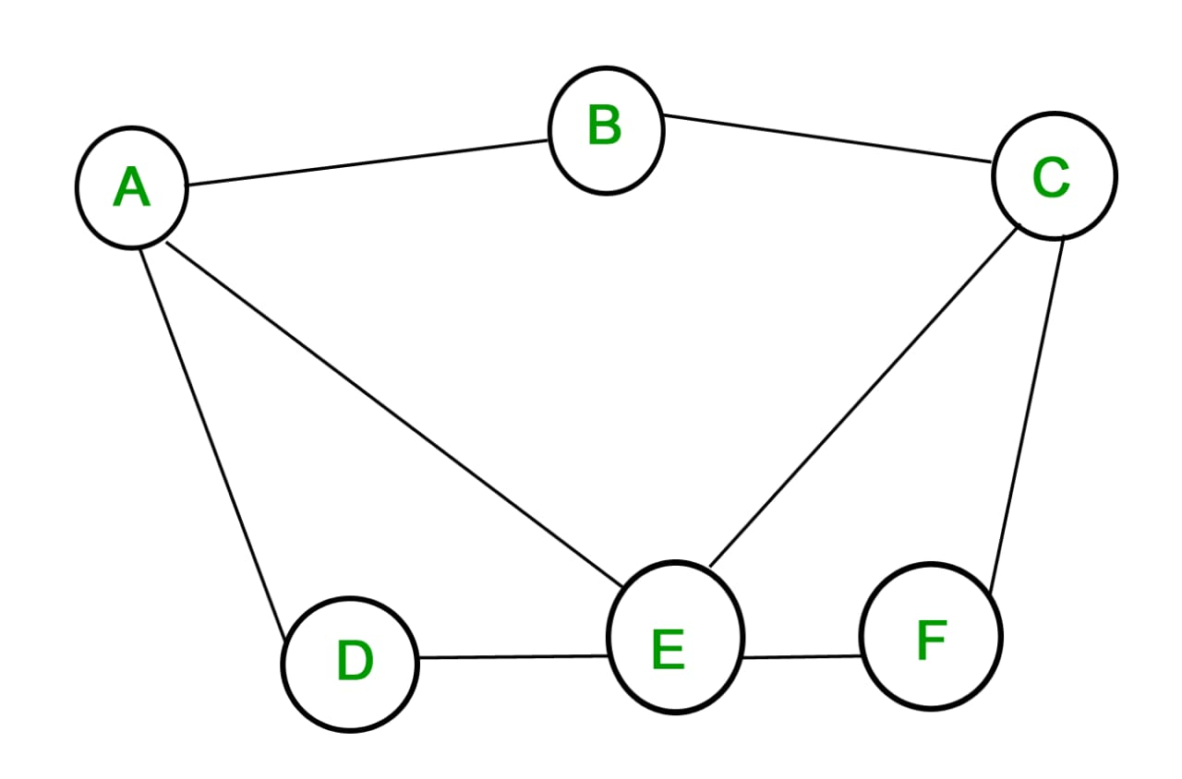
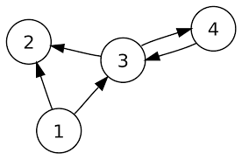
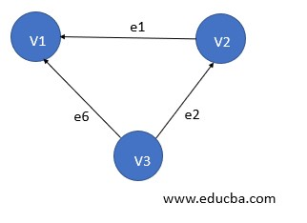
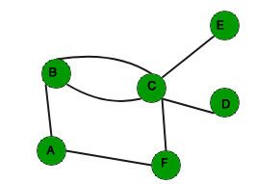
Graphs:
Undirected Graph
Directed Graph
DAG
Multi Graph

Slide 7
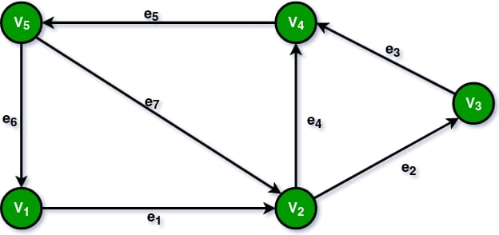
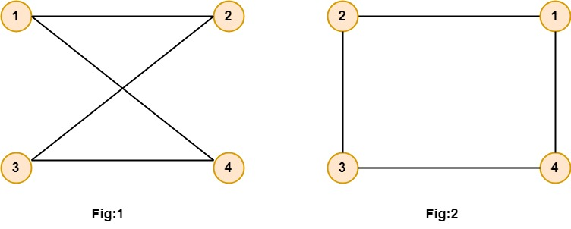
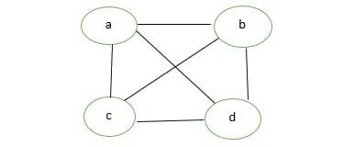
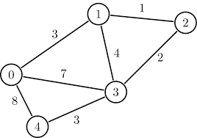
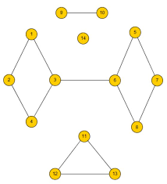
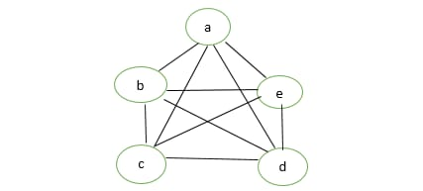
Simple Graph
Labelled Graph
Complete Graph
Unconnected Graph
Weighted Graph
Connected Graph
Complete Graph

Slide 8
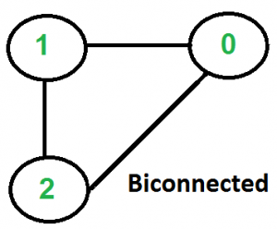
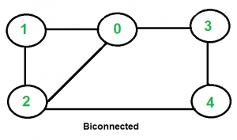
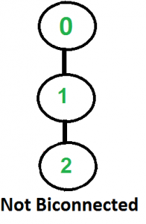
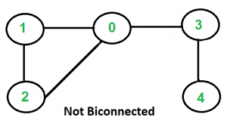
Bi connected Graph:
A graph is said to be Bi connected if: 1) It is connected, i.e. it is possible to reach every vertex from every other vertex, by a simple path. 2) Even after removing any vertex the graph remains connected i.e., should not have any articulation point.

Slide 9
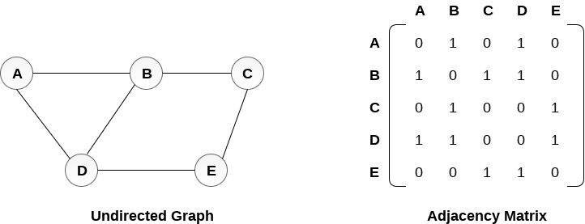
Representation of Graphs:
Adjacency Matrix representation
An adjacency matrix is a square matrix used to represent a finite graph. The elements of the matrix represent whether pairs of vertices are adjacent or not in the graph.
Note:- Check the class notes for why we are moving for adjacency matrix representation

Slide 10

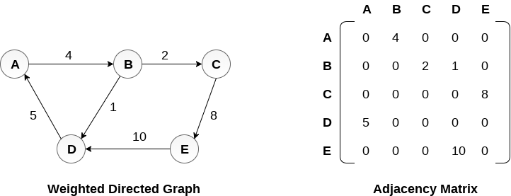
Adjacency Matrix representation (Cont…)

Slide 11
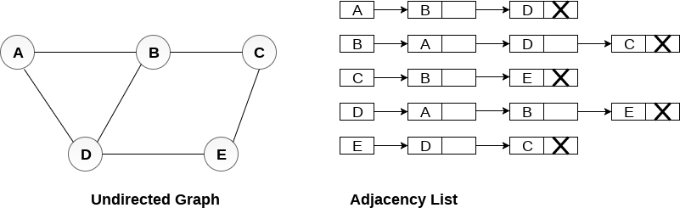
2) Adjacent List representation:
An adjacency list representation of a graph associates each vertex in the graph with collection of its neighboring vertices or edges i.e., every vertex stores list of adjacent vertices.
Note:- Check the class notes for why we are moving for adjacency matrix representation

Slide 12
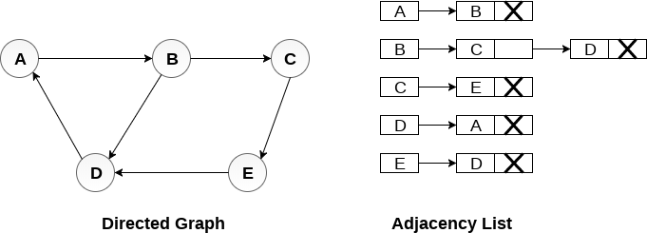
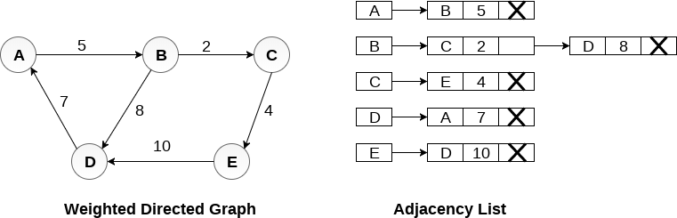
2) Adjacent List representation ( cont…):

Slide 13
Adjacency matrix vs. adjacency list representation
Adjacency matrix
Good for dense graphs --|E|~O(|V|²)
Memory requirements: O(|V| + |E| ) = O(|V|² )
Connectivity between two vertices can be tested quickly
Adjacency list
Good for sparse graphs -- |E|~O(|V|)
Memory requirements: O(|V| + |E|)=O(|V|)
Vertices adjacent to another vertex can be found quickly

Slide 14
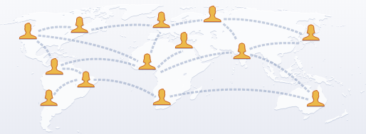
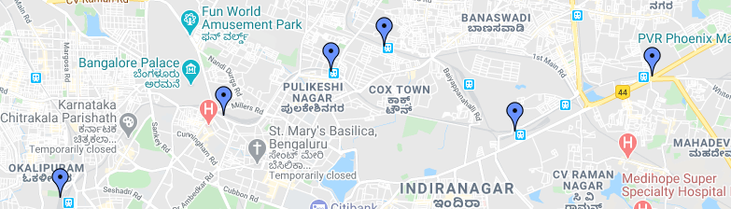
Applications of Graphs:
Social Networking sites
Interlinking of Web pages.
Transportation networks
Social Networking sites
Transportation networks

Slide 15
Graph Traversals:
1)Breadth-First Traversal
In Breadth First Traversal, one vertex is selected at first then it is visited and marked.
It uses a queue for storing the visited vertices.
The vertices adjacent to the visited vertex are then visited and stored in the queue sequentially. Similarly, the stored vertices are then treated one by one, and their adjacent vertices are visited.
A node is fully explored before visiting any other node in the graph, in other words, it traverses shallowest unexplored nodes first.
Applications:
BFS can be useful in finding whether the graph has connected components or not and also it can be used in detecting a bipartite graph.

Slide 16
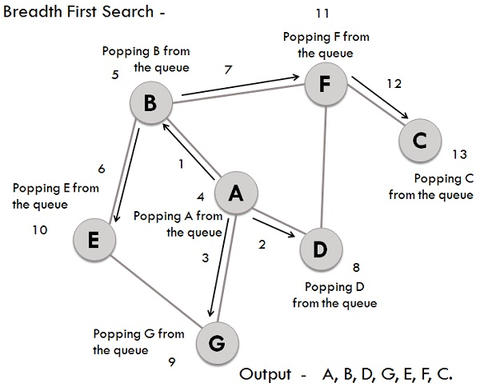
BFS with example:-
We have a graph whose vertices are A, B, C, D, E, F, G. Considering A as starting point. The steps involved in the process are:
Vertex A is expanded and stored in the queue.
Vertices B, D and G successors of A, are expanded and stored in the queue meanwhile Vertex A removed.
Now B at the front end of the queue is removed along with storing its successor vertices E and F.
Vertex D is at the front end of the queue is removed, and its connected node F is already visited.
Vertex G is removed from the queue, and it has successor E which is already visited.
Now E and F are removed from the queue, and its successor vertex C is traversed and stored in the queue.
At last C is also removed and the queue is empty which means we are done.
The generated Output is – A, B, D, G, E, F, C.

Slide 17
Algorithm for BFT:
BFS(Node start) {
initialize queue q to hold start
mark start as visited
while(q is not empty) {
next = q.dequeue() // and "process"
for each node u adjacent to next
if(u is not marked)
mark u and enqueue onto q
}
}
A
B
C
D
E
F
G
H
Order processed: A, B, C, D, E, F, G, H

Slide 18
Graph Traversals:
1)Depth-First Traversal
DFS is the edge based method and works in the recursive fashion where the vertices are explored along a path (edge).
The exploration of a node is suspended as soon as another unexplored node is found and the deepest unexplored nodes are traversed at foremost.
DFS traverse/visit each vertex exactly once and each edge is inspected exactly twice.
It uses the stack for storing the visited vertices.
Applications:
The applications of DFS includes the inspection of two edge connected graph, strongly connected graph, acyclic graph, and topological order.

Slide 19
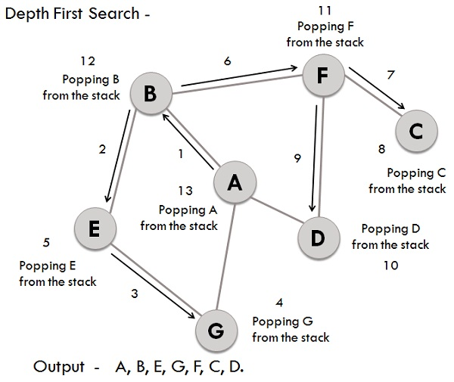
DFS with example:-
For the same BFS graph, lets construct DFS:
Considering A as the starting vertex which is explored and stored in the stack.
B successor vertex of A is stored in the stack.
Vertex B have two successors E and F, among them alphabetically E is explored first and stored in the stack.
The successor of vertex E, i.e., G is stored in the stack.
Vertex G have two connected vertices, and both are already visited, so G is popped out from the stack.
Similarly, E s also removed.
Now, vertex B is at the top of the stack, its another node(vertex) F is explored and stored in the stack.
Vertex F has two successor C and D, between them C is traversed first and stored in the stack.
Vertex C only have one predecessor which is already visited, so it is removed from the stack.
Now vertex D connected to F is visited and stored in the stack.
As vertex D doesn’t have any unvisited nodes, therefore D is removed.
Similarly, F, B and A are also popped.
The generated output is – A, B, E, G, F, C, D.

Slide 20
Algorithm for DFS
DFS2(Node start) {
initialize stack s to hold start
mark start as visited
while(s is not empty) {
next = s.pop() // and "process"
for each node u adjacent to next
if(u is not marked)
mark u and push onto s
}
}
A
B
C
D
E
F
G
H
Order processed: A, C, F, H, G, B, E, D

Slide 21
Difference between BFS and DFS:
Queue is used in BFS and DFS uses stack.
DFS constructs narrow and long trees where as BFS constructs wide and short tree.
Memory space is efficiently utilized in DFS while in BFS it is not effective.
BFS is vertex-based algorithm while DFS is an edge-based algorithm.
BFS is optimal algorithm while DFS is not optimal.

Slide 22
Some Applications of BFS and DFS
BFS
To find the shortest path from a vertex s to a vertex v in an unweighted graph
To find the length of such a path
To find out if a strongly connected directed graph contains cycles
To construct a BSF tree/forest from a graph
DFS
To find a path from a vertex s to a vertex v.
To find the length of such a path.
To construct a DFS tree/forest from a graph.

Slide 23
Topological Sorting

Slide 24
Topological Sort - Example
Example: Professor Bumstead’s order of dressing
socks
shorts (1/10)
shirt (11/14)
socks (15/16)
shorts
pants
shoes
pants (2/9)
tie (12/13)
shirt
belt
belt (3/6)
shoes (7/8)
tie
jacket (4/5)
jacket
Final order: socks, shirt, tie, shorts, pants, shoes, belt, jacket
Total Running Time: O(n+e)

Slide 25
Topological Sorting
A topological sort or topological ordering of a directed graph is a linear ordering of its vertices such that for every directed edge (u,v) from vertex u to vertex v, u comes before v in the ordering.
The vertices of the graph may represent tasks to be performed, and the edges may represent constraints that one task must be performed before another.
A topological ordering is just a valid sequence for the tasks.

Slide 26
Topological Sorting
A topological ordering is possible if and only if the graph has no directed cycles, that is, if it is a directed acyclic graph (DAG).
Any DAG has at least one topological ordering, and algorithms are known for constructing a topological ordering of any DAG in linear time.
Scheduling a sequence of jobs or tasks based on their dependencies. The jobs are represented by vertices, and there is an edge from x to y if job x must be completed before job y can be started
When washing clothes, the washing machine must finish before we put the clothes in the dryer.

Slide 27
Topological Sort: Definition
Consider the following graph of course prerequisities
201
306
427
111
123
213
304
446
205
Problem: Find an order
in which all these
courses can be taken.
220
302
402
To take a course, all of its prerequisites must be taken first
Example: 111, 123, 201, 213, 304, 306, 427, 205, 446, 220, 302, 402

Slide 28
Topological Sorting Problem
Given digraph G = (V, E), find a linear ordering of its vertices such that: for any edge (u, v) in E, u precedes v in the ordering
How would you topo-sort this graph given an adjacency list representation of G=(V, E)?
B
C
A
F
D
E

Slide 29
Topological Sorting Problem
Given digraph G = (V, E), find a linear ordering of its vertices such that: for any edge (u, v) in E, u precedes v in the ordering
Any linear ordering in which all arrows go to the right is a valid ordering
B
C
A
F
D
E
A
B
F
C
D
E

Slide 30
Topological Sort
Given digraph G = (V, E), find a linear ordering of its vertices such that: for any edge (u, v) in E, u precedes v in the ordering
B
C
A
F
Not a valid topological sort
D
E
A
B
F
D
C
E

Slide 31
Topological Sort Algorithm
Step1: Identify vertices that have no incoming edge
in-degree of these vertices is 0
B
C
A
F
D
E

Slide 32
Topological Sort Algorithm
Step1: Identify vertices that have no incoming edge
If no such vertices, the graph has cycles (cyclic)
Cyclic graphs cannot be topo-sort
Only Directed Acyclic Graphs (DAG) can be topologically sorted
B
C
A
An example cyclic graph:
No vertex with in-degree = 0
D

Slide 33
Topological Sort Algorithm
Step1: Identify vertices that have no incoming edge
Select one such vertex
B
C
Select
A
F
D
E

Slide 34
Topological Sort Algorithm
Step 2: Output the vertex
Delete this vertex and all of its outgoing edges from the graph
B
C
A
F
D
E
B
C
F
Output:
A
D
E

Slide 35
Topological Sort Algorithm
Repeat Steps 1 & 2 until the graph is empty
Select
Delete B &
all its outgoing
edges
B
C
C
F
F
D
E
D
E
Output:
A
B

Slide 36
Topological Sort Algorithm
Repeat Steps 1 & 2 until the graph is empty
Select
Delete F &
all its outgoing
edges
C
C
F
D
E
D
E
Output:
A
B
F

Slide 37
Topological Sort Algorithm
Repeat Steps 1 & 2 until the graph is empty
Select
Delete C &
all its outgoing
edges
C
D
E
D
E
Output:
A
B
F
C

Slide 38
Topological Sort Algorithm
Repeat Steps 1 & 2 until the graph is empty
Select
Delete D &
all its outgoing
edges
D
E
E
Output:
A
B
F
C
D

Slide 39
Topological Sort Algorithm
Repeat Steps 1 & 2 until the graph is empty
Select
Delete E &
all its outgoing
edges
E
Empty Graph
Output:
A
B
F
C
D
E

Slide 40
Summary of Top-Sort Algorithm
Store each vertex’s In Degree (# of incoming edges) in an array
while (there are vertices remaining)
{
Find a vertex with In-Degree zero and output it
Reduce in-degree of all vertices adjacent to it by 1
Mark this vertex deleted (in-degree = -1)
} /* end=while */
B
C
A
F
D
E
In-
degree
0
A
B
D
1
B
C
1
C
D
E
2
D
E
2
E
0
F

Slide 41
Running Time Analysis
For input graph G = (V,E), Running Time = ?
Break down into total time required to:
Initialize In-Degree array: O(n+e)
Find vertex with in-degree 0: O(n)
N vertices, each takes O(n) to search In-Degree array. Total time = O(n²)
Reduce In-Degree of all vertices adjacent to a vertex: O(e)
Output and mark vertex: O(n)
Total time = O(n² + e) - Quadratic time!
Can we do better than this?
Problem: a faster way to find a vertex with in-degree = 0

Slide 42
Making Top-Sort Faster
Key idea: Initialize and maintain a queue (or stack) of vertices with In-Degree 0
In-
degree
Queue:
A
F
0
A
B
D
1
B
C
B
C
1
C
D
E
A
F
2
D
E
2
E
D
E
0
F

Slide 43
Making Top-Sort Faster
After each vertex is output, update In-Degree array, and enqueue any vertex whose In-Degree has become zero
Enqueue
Queue:
F
B
In-
degree
Dequeue
0
A
B
D
Output:
A
0
B
C
B
C
1
C
D
E
A
F
1
D
E
2
E
D
E
0
F

Slide 44
Fast Top-Sort Algorithm
Store each vertex’s In-Degree in an array
2. Initialize a queue with all in-degree zero vertices
3. while (there are vertices remaining in the queue) {
3.1. Dequeue and output a vertex
3.2. Reduce In-Degree of all vertices
adjacent to it by 1
3.3. Enqueue any of these vertices whose In-Degree
became zero
} //end-while
Running Time Analysis:
Step 1 – Initialization - O(n+e)
Step 2 – Initialize Q – O(n)
Step 3.1 – O(1) – n times – O(n)
Step 3.2 + 3.3 – O(e)
Total Running Time – O(n+e) - Linear

Slide 45
Topological Sort – Using DFS
There is another O(n+e) algorithm for topological sort that is based on the DFS
Think about how DFS works
We start from a vertex, and go all the way down the graph until we can go no further
This means that the node deepest down the tree must come last in topological order, followed by its ancestors and so on
To state this in another way, for every edge (u, v) in a DAG, the finish time of u is greater than the finish time of v.
Thus it suffices to output the vertices in reverse order of finishing time.

Slide 46
Topological Sort – based on DFS
TopSort(G){
for each u in V { // Initialization
color[u] = white;
} //end-for
L = new linked_list; // L is an empty linked list
for each u in V
if (color[u] == white)
TopVisit(u);
return L; // L gives the final order
} // end-TopSort
TopVisit(u){ // Start a new search at u
color[u] = gray; // Mark u visited
for each v in Adj[u] {
if (color[v] == white){ // if neighbor v undiscovered
TopVisit(v); // …visit v
} //end-if
} //end-for
color[u] = black; // we are done with u
Put u to the front of L; // on finishing add u to the list
} //end-while
} //end-TopVisit

Slide 47
Topological Sort - Example
Example: Professor Bumstead’s order of dressing
socks
shorts (1/10)
shirt (11/14)
socks (15/16)
shorts
pants
shoes
pants (2/9)
tie (12/13)
shirt
belt
belt (3/6)
shoes (7/8)
tie
jacket (4/5)
jacket
Final order: socks, shirt, tie, shorts, pants, shoes, belt, jacket
Total Running Time: O(n+e)

Slide 48
Queries???
(anilkumar10491@rguktsklm.ac.in)

